Slide 1
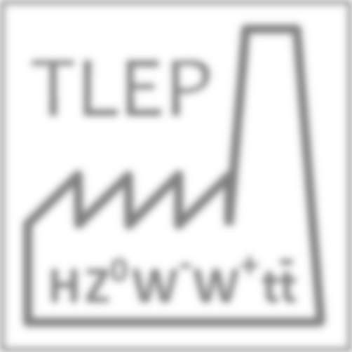
TLEP: a first step on a long vision for HEP
M. Koratzinos
On behalf of the TLEP steering group
Chios, 27 April 2013

Slide 2
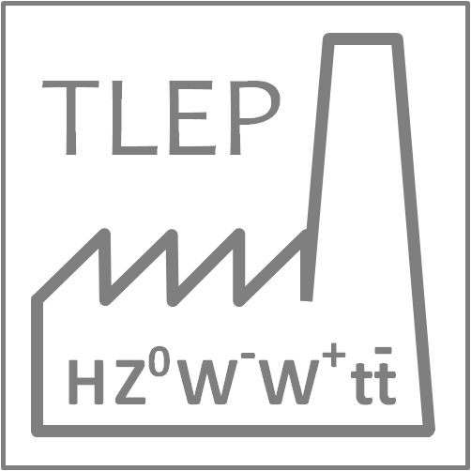
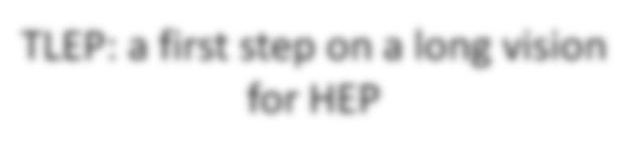

Slide 3
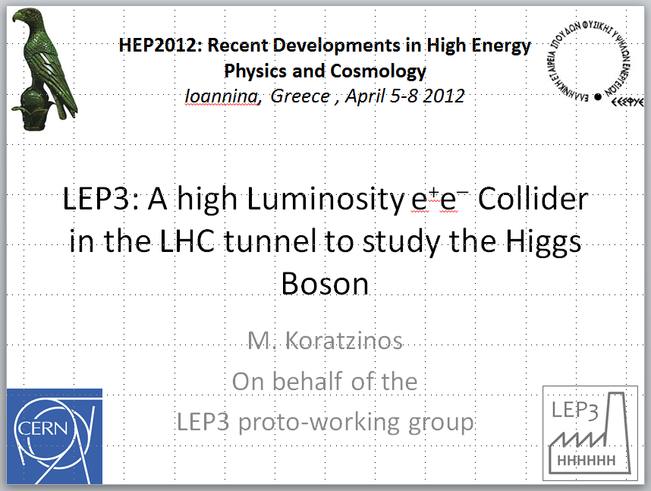
You have heard it here first!

Slide 4
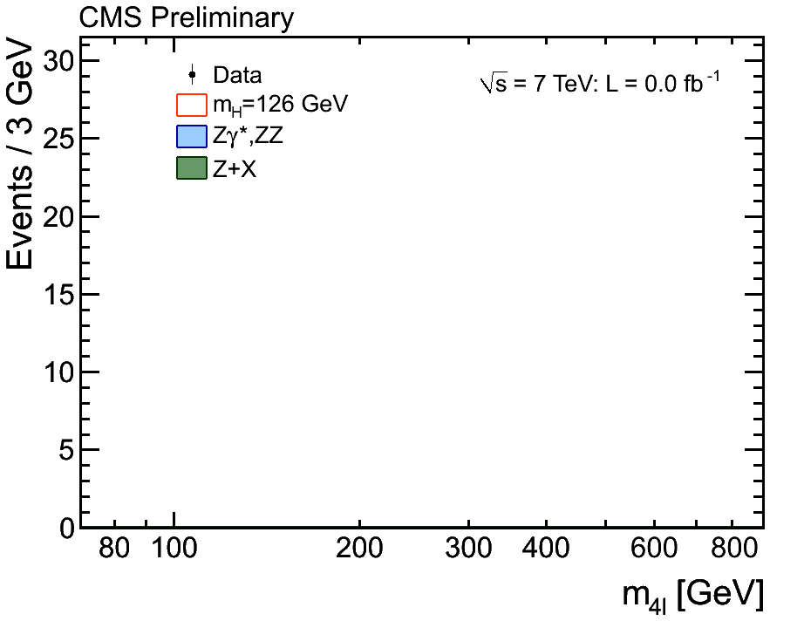

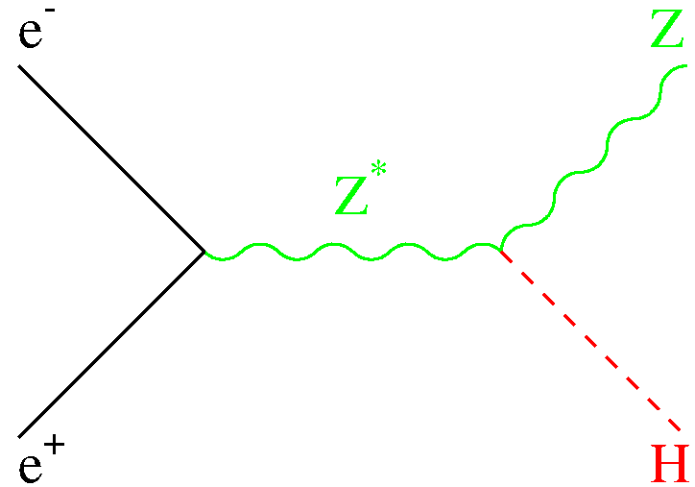
Scientific Motivation for TLEP (1)
A new boson with mass ~ 126 GeV, and with SMS properties
  Example : H(126) → ZZ → 4 leptons in CMS and ATLAS
    H(126) couples to the Z boson : important for e⁺e⁻ colliders!
      g_{HZZ} compatible with SM prediction (within ±30%)
      Scalar hypothesis favoured
      m_{H} known to ~ 400 MeV
      σ_{HZ} largest at √s = 250 GeV
Moriond EW ’13

Slide 5
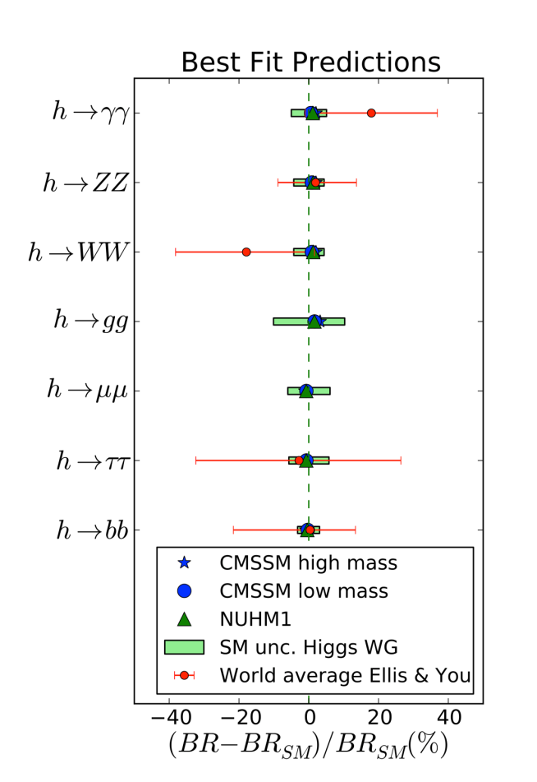
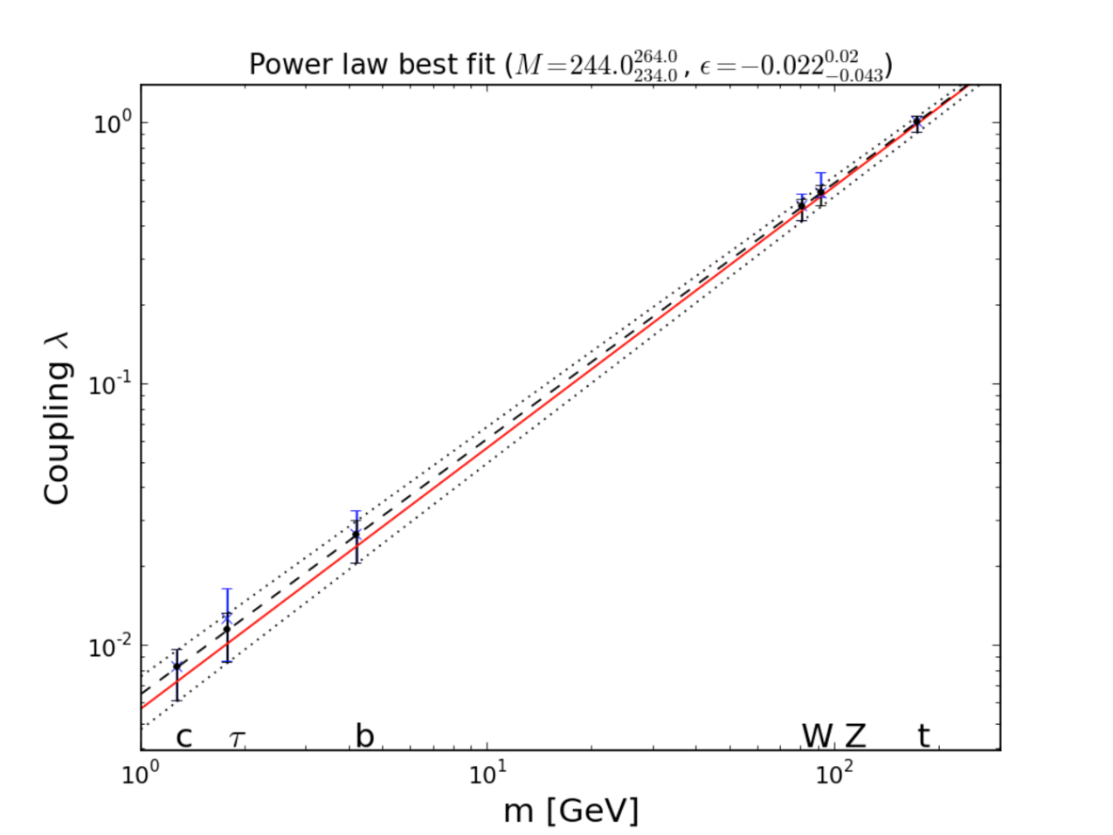

Scientific Motivation for TLEP (2)
The discovered Higgs boson is indeed (very) Standard
  A summary of all available data so far :
  A sign that New Physics might not be around the corner
    As it would modify the Higgs branching fractions (How much ? See in a few slides.)
      Need to measure more precisely (How precisely ? See in a few slides.)
J. Ellis et al.
Global fit
Red line = SM, dashed line = best fit

Slide 6
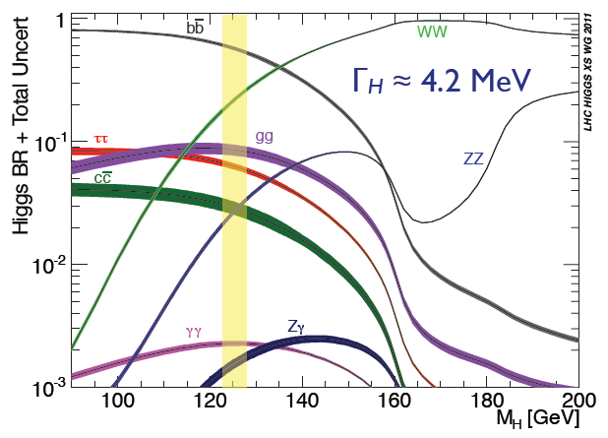
Higgs measurements
Precision needed for Higgs measurements ?
  Does H(126)
    Couple to fermions ?
    Account for fermion masses ?
    Fully account for EWSB ?
    Has SM coupling to gauge bosons ?
    Decay to new, visible, particles ?
    Decay to invisible particles ?
    Have the “proper” mass and width ?
    Show any sign of new physics ?
  What is the precision needed to answer all these questions in a useful manner ?
    We attempt to answer in the next slide
57.9 ± 1.7 %
21.6 ± 0.6 %
6.4 ± 0.4 %
8.2 ± 0.8 %
2.8 ± 0.3 %
2.6 ± 0.1 %
0.27 ± 0.02 %
PJ and G. Ganis
S. Dittmaier et al

Slide 7
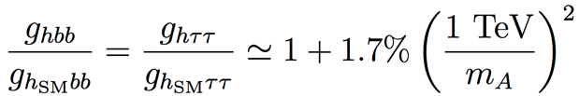
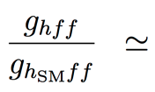
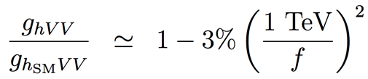
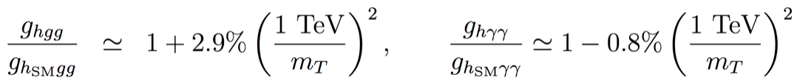
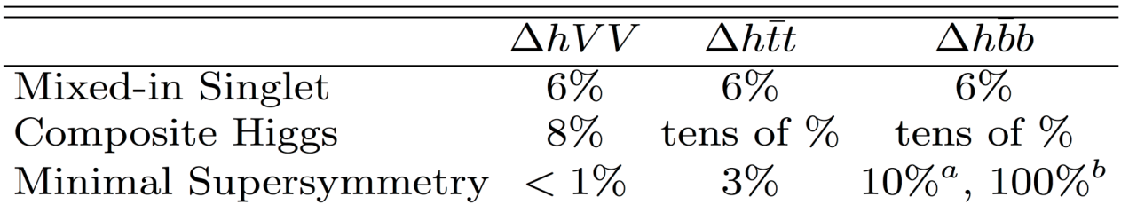
How accurately do we need to measure the Higgs couplings?
Example : Precision for Higgs couplings
  Maximum deviations with respect to SM couplings, as a function of new physics scale
    SUSY , for tanβ = 5
    Composite Higgs
    Top partners
    Other models may give up to 5% deviation with respect to the Standard Model
  Maximal deviations for the new physics scale still allowed by LHC results
This strongly influences the strategy for Higgs factory projects
  Need at least a per-cent accuracy on couplings for a 5σ “observation”
    And sub-percent precision if new physics is at the (multi-)TeV scale
H. Baer, M. Peskin et al.
J.D. Wells et al.

Slide 8
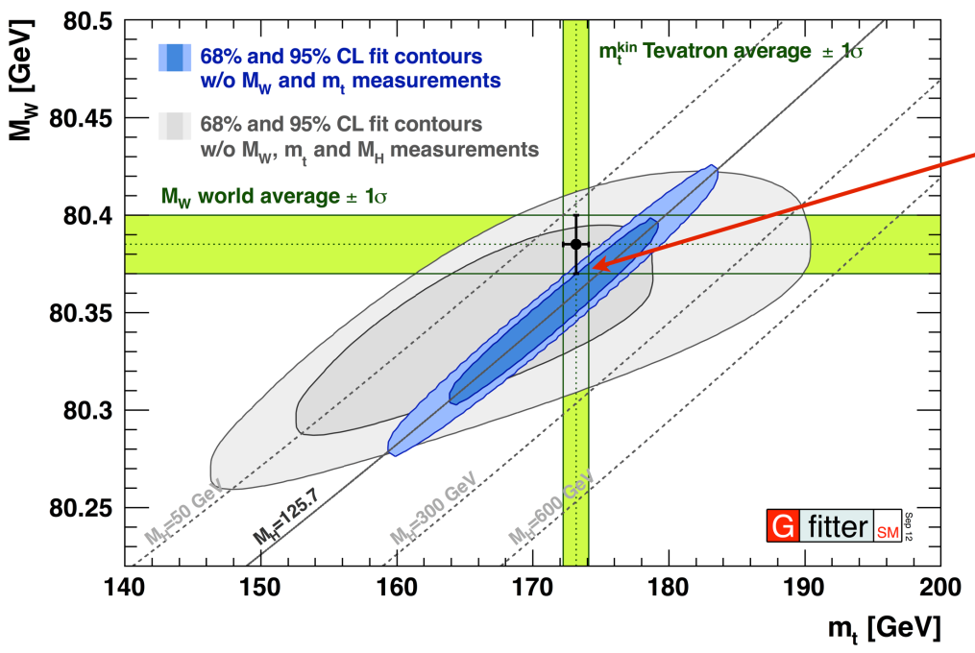
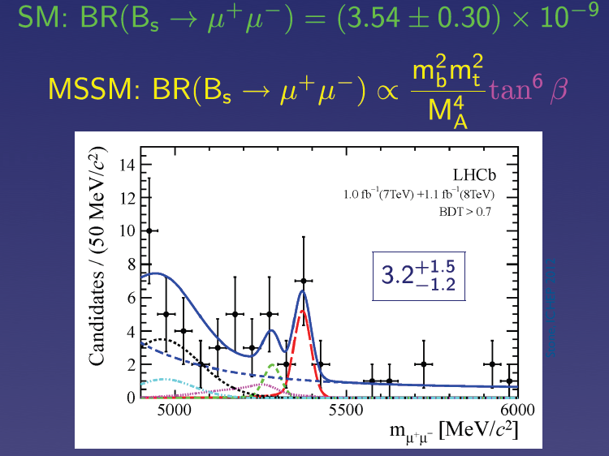
SM closure tests
If no new physics is found, what next ?
  Once m_{H} is known, the standard model has nowhere to go !
    Very strong incentive to revisit and improve all precision measurements
      Z pole, WW threshold
      Higgs couplings
      Top quark properties
      Rare decays (B_{s} → μμ, etc.)
    To become sensitive to (multi-)TeV New Physics
LHCb 2013
R. Kogler et al.
→ Programme unique to TLEP
→ Integrated luminosity unique to TLEP
→ Also at the Z pole, unique to TLEP

Slide 9
Precision at the LHC
The LHC *is* a Higgs factory. However, precision does not reach the sub-percent level needed to look for deviations Beyond the SM
Approved LHC, 300 fb⁻¹ at 14 TeV :
  Higgs mass at 100 MeV
  Disentangle Spin 0 vs Spin 2 and main CP component in γγ/ZZ*
  Coupling precision / Experiment
    ZZ, WW, 5-6%
    bb, ττ 10-15%
    tt, μμ 3-2 σ effect
    γγ , gg 5-11%
HL-LHC, 3000 fb⁻¹ at 14 TeV:
  Higgs mass at 50 MeV
  More precise studies of Higgs CP sector
  Coupling precision / Experiment
    ZZ, ZW, 1-5%
    bb, ττ, tt, μμ 3-10%
    γγ and gg 2-7%
    HH >3 σ (2 Expts)
Assuming sizeable reduction of theory errors
CMS (#177) and ATLAS (#174) contributions to the European Strategy (2012)

Slide 10
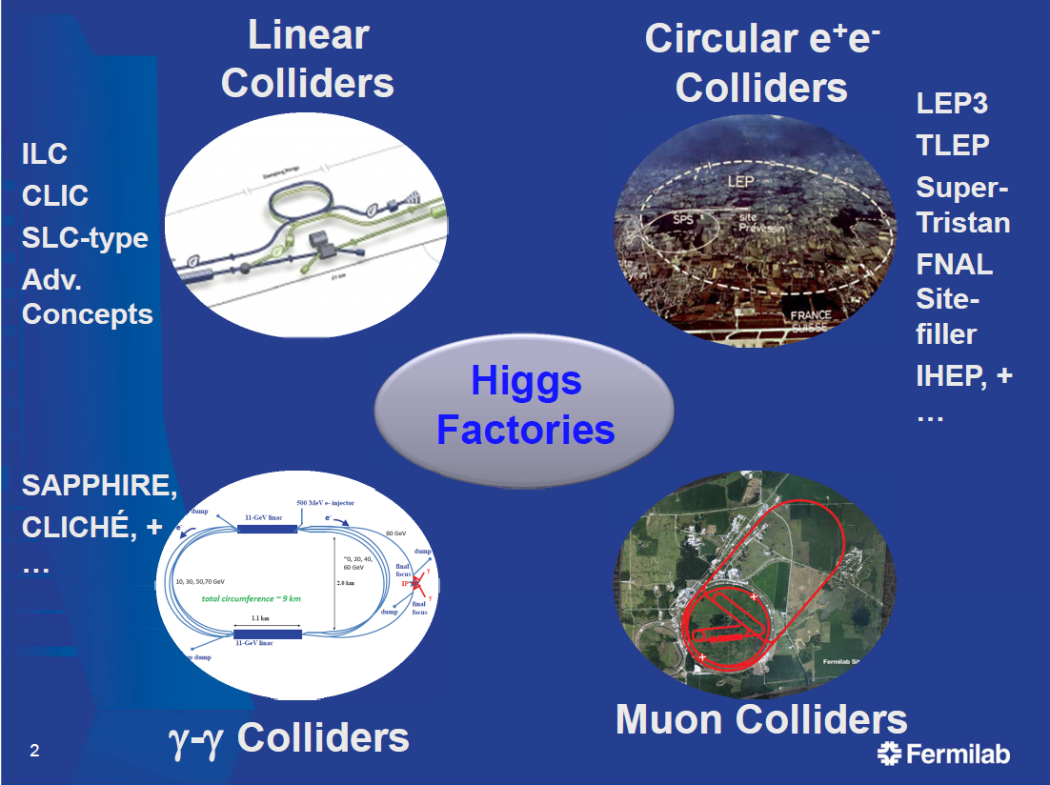
Paths towards the future : Precision Higgs Factories
Several options for Higgs factories are being studied
Studied for decades
This talk
(mostly TLEP)
Not encouraged by
European Strategy
Smaller Physics
Potential
e⁺e⁻ colliders have largest potential
as Precision Higgs Factories

Slide 11
A circular machine?
LEP2 reached the HZ production threshold to within 15%...
…so nature has given us a gift with the light Higgs: the next Higgs factory does not necessarily need to be a linear!
Therefore we can take advantage of the progress in circular machines since the time of LEP, and we can come up with a machine with much higher luminosity
Crucially, this luminosity is higher than what can be achieved at linear machines, and a circular machine has the potential for multiple interaction points…
…but it is not (per ce) upgradable in energy, with a ‘brick wall’ reached above around 350GeV

Slide 12
Challenges (accelerator)
Can high luminosity be achieved?
Is the synchrotron radiation (that increases fast with energy) manageable?
Can an RF system be built to supply the energy lost in SR?
Can the power consumption of such a machine be reasonable?
Are there any showstoppers regarding achieving the above goals? (beamstrahlung)

Slide 13
Luminosity
It turns out that luminosity is a function of
  Macroscopic parameters:
    bending radius
    power consumption
    Beam energy
  Accelerator parameters:
    Beta*_y (and longitidinal beam size)
    Vertical beam-beam parameter
…while respecting beamstrahlung limits

Slide 14
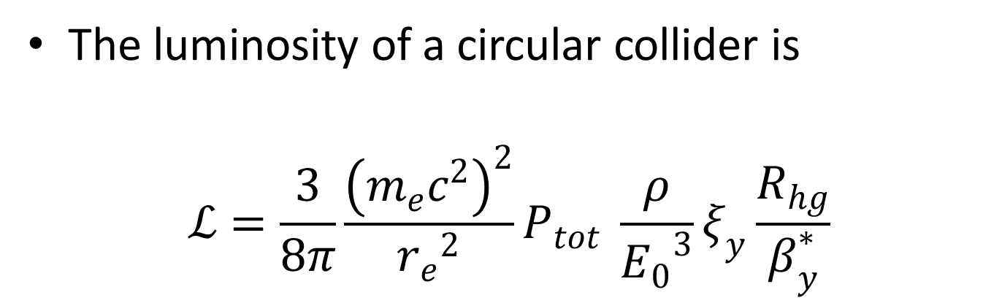
Luminosity
The luminosity of a circular collider is
$$ℒ=\frac{3}{8π}\frac{{\left(m_{e}c^{2}\right)}^{2}}{{r_{e}}^{2}}P_{tot} \frac{ρ}{{E_{0}}^{3}}ξ_{y}\frac{R_{hg}}{β_{y}^{∗}}$$
~0.7
~1mm
constants
Total SR power
Bending radius
Beam energy
Beam-beam parameter (=0.03 to 0.15)

Slide 15
Maximum luminosity
…for a given energy, tunnel radius and power dissipation, effectively depends on what kind of a beam-beam parameter we can reach (the beam-beam limit).
Extrapolating from LEP we get the following (together with the expected luminosities for the ILC and CLIC):
TLEP:
ρ = 9000km
P_{SR} = 100MW
TLEP
ILC
CLIC
My own extrapolation – not endorsed by TLEP
Caveat: provided no Beamstrahlung limitations

Slide 16
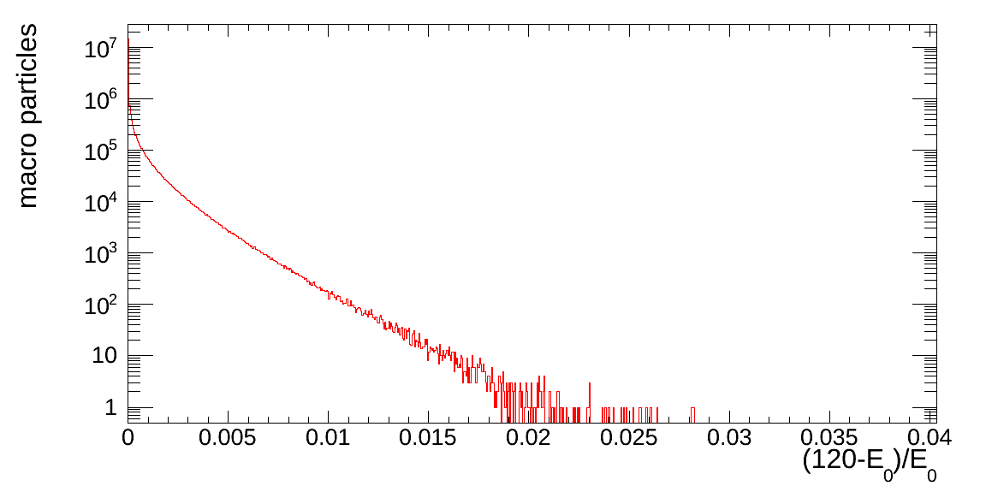
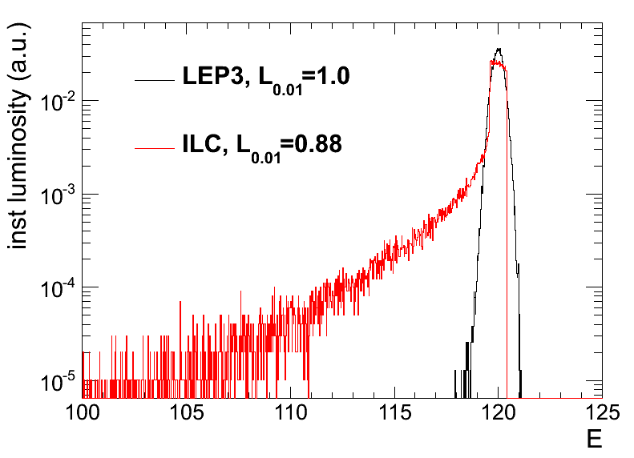
Beamstrahlung
Beamstrahlung is the effect of an incoming electron radiating a hard photon in the presence of the electric field of the opposing beam. In circular colliders this might affect beam lifetimes. In linear colliders it smears the beam energy.
If the number of photons above the momentum acceptance of the machine radiated in every collision is high, the beam lifetime suffers
M. Zanetti
Momentum acceptance
M. Zanetti
The effect of beamstrahlung is very strong in linear colliders and it results in smearing the beam energy

Slide 17
Beamstrahlung mitigation
The mitigation possibilities against low lifetimes due to beamstrahlung are:
  High momentum acceptance
  Very flat beams (high ratio of horizontal to vertical emittance)
  High top-up rate
  Charge compensation

Slide 18
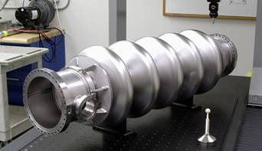
RF issues
TLEP energy loss per turn @ 175GeV: 9GeV
Choice of frequency: 700-800MHz
Choice of accelerating gradient: 20MV/m dictated by efficiency (up to 35MV/m possible)
Total length of RF system: 900m (LEP2 850m)
Total accelerating power: 12GV (@175GeV)
Working on a preliminary power estimate
Preliminary power consumption RF system
 | TLEP 120 | TLEP 175
RF systems | 173-185 MW
cryogenics | 34 MW
top-up ring | 3 MW | 5 MW
Total RF | ~220 MW | ~220 MW
BNL 5-cell 700 MHz cavity

Slide 19
What size for a circular collider?
Luminosity:
  There is a relationship between luminosity and bending radius – so the bigger the better
  (this relationship is not so straightforward due to the interplay between radius and beam-beam limit)
Energy reach:
  Here size really matters
    A 80km ring can reach the ttbar threshold of 350GeV
    A 27km ring can reach the ZH threshold at 240GeV
Our strategy:
  Aim for TLEP in a new tunnel which will later house a very high energy pp collider
  LEP3 is a backup in case of severe financial limitations

Slide 20
TLEP : a unique Higgs Factory … and much more !
(CERN implementation)
With a new 80-100 km circular tunnel :
  TLEP Physics case : Precision measurements sensitive to multi-TeV New Physics
    TeraZ (√s~m_{Z}), MegaW (√s~2m_{W}), Higgs Factory (√s~240 GeV), top (√s~350 GeV)
      With luminosity 20-1000 × larger than projects of similar timescale and cost
  Followed by VHE-LHC : Direct search for New Physics in the 10-100 TeV range
    √s ~ 100 TeV (with 20T magnets)
      Also allows the HHH coupling to be measured to a few %
(9 GeV lost per turn)
F. Zimmermann
PSB
PS (0.6 km)
LHC (26.7 km)
SPS (6.9 km)
HE-LHC (33 TeV)
LEP3 : e⁺e⁻, up to
√s ~ 240 GeV
VHE-LHC : pp,
√s ~ 100 TeV
TLEP : e⁺e⁻, up to
√s ~350 GeV

Slide 21
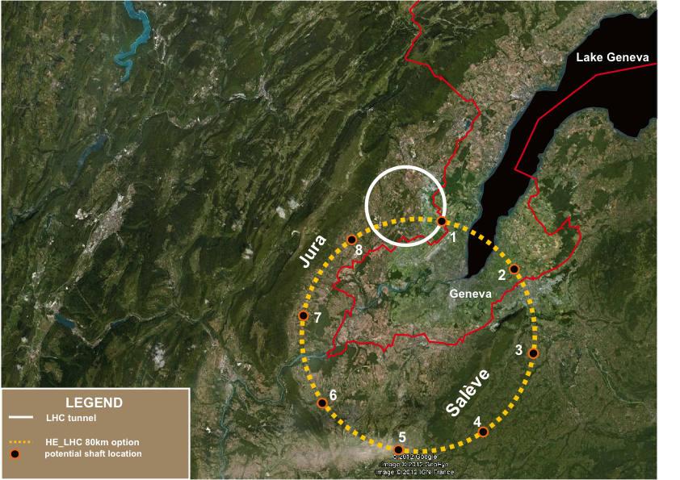
80-km tunnel in Geneva area – “best” option
«Pre-Feasibility Study for an 80-km tunnel at CERN»
John Osborne and Caroline Waaijer,
CERN, ARUP & GADZ, submitted to ESPG
even better
100 km?

Slide 22
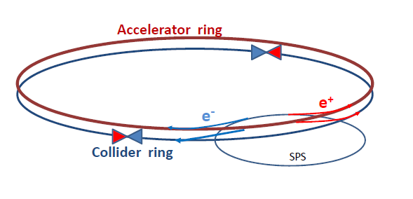
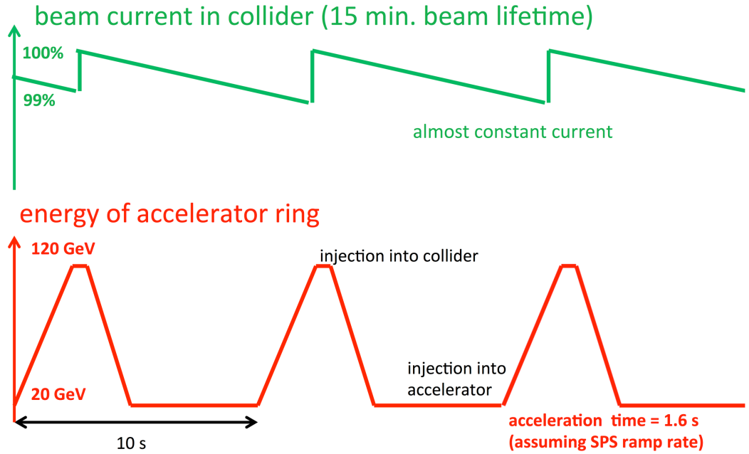
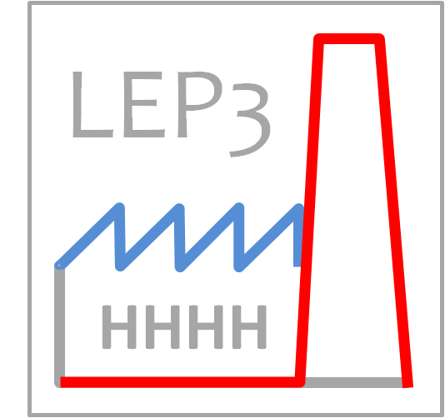
Beam lifetime at TLEP
At these luminosities, beam lifetime ~ 15 minutes (Bhabha scattering)
  Solution : double ring and continuous top-up injection, as at PEP-II
    Note : Soon to be realized at Super-KEKB, beam lifetime ~ 5 minutes
        Top-up injection : Schematic cycle
        (Provisional logo)
        Contest to be organized !
A. Blondel
F. Zimmermann
TLEP
M. Koratzinos

Slide 23
Power consumption
TLEP would consume a bit more than the current contract of CERN with EdF (200MW), but would produce more Higgs particles per watt than any other similar project
Very preliminary
Power consumption | TLEP 175
RF including cryo | 230MW
cooling | ~5MW
ventilation | 27MW
Magnet system | 14MW
experiments | 25MW
General services | 15MW
Polariz. wigglers | –
Total | ~320MW

Slide 24
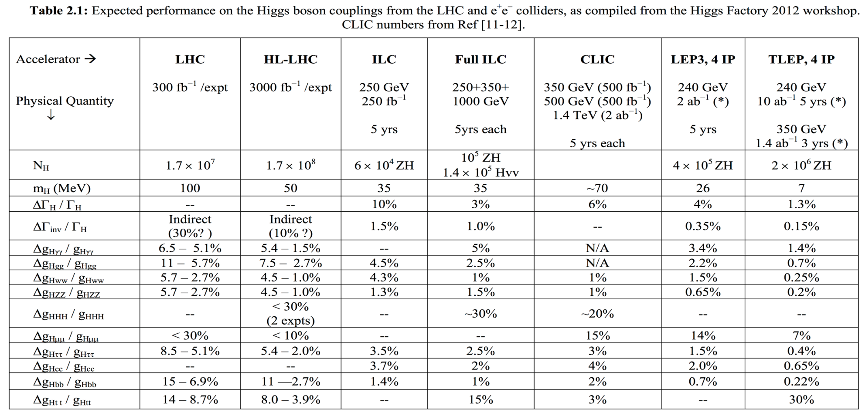
TLEP Physics case as a Higgs Factory
Summary of the ICFA Higgs Factory Workshop (FNAL, Nov. 2012)
Best
precision

Slide 25
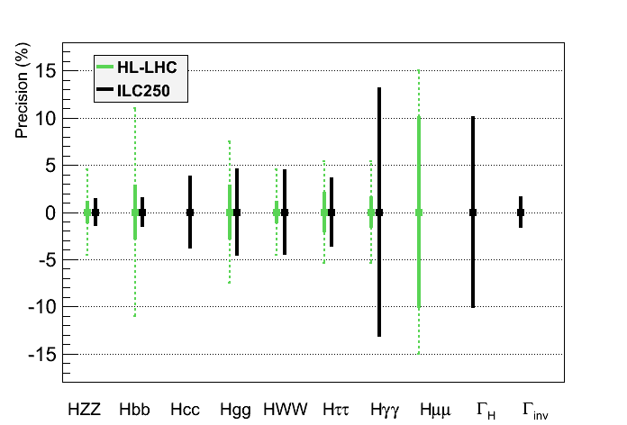
TLEP physics case as a Higgs factory
Same assumptions as for HL-LHC for a sound comparison
  Total width fixed to the sum of the visible partial widths + correction (Δg/g ~ 1/2 ΔBR/BR)
      ILC250 would complement LHC (esp. for Γ_{H} , Γ_{inv} , g_{Hcc} , g_{Hbb})

Slide 26
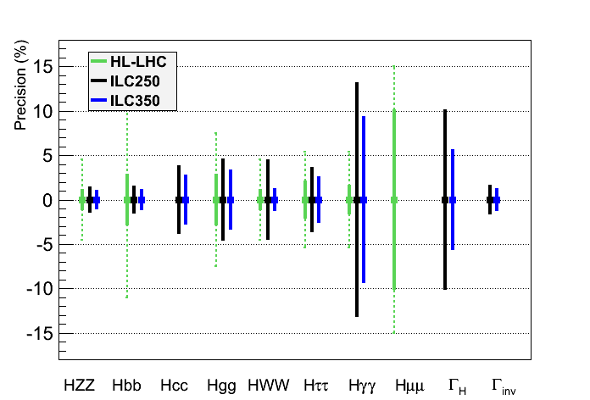
TLEP physics case as a Higgs factory
Same assumptions as for HL-LHC for a sound comparison
  Total width fixed to the sum of the visible partial widths + correction (Δg/g ~ 1/2 ΔBR/BR)
      ILC250/350 would further complement LHC, but does not cover the physics case

Slide 27
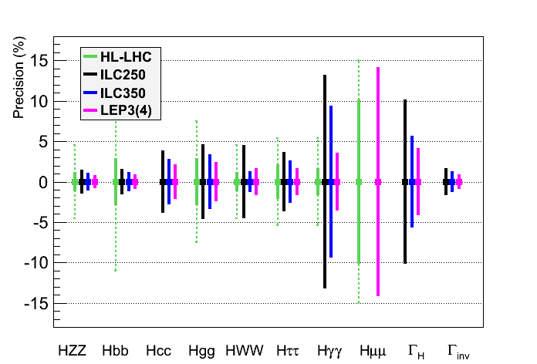
TLEP physics case as a Higgs factory
Same assumptions as for HL-LHC for a sound comparison
  Total width fixed to the sum of the visible partial widths + correction (Δg/g ~ 1/2 ΔBR/BR)
      LEP3 would be an advantageous back-up : larger lumi, several IPs, smaller cost

Slide 28
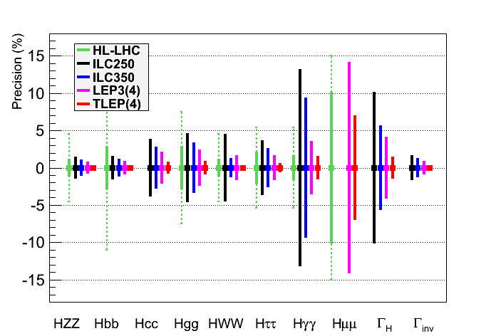
TLEP physics case as a Higgs factory
Same assumptions as for HL-LHC for a sound comparison
  Total width fixed to the sum of the visible partial widths + correction (Δg/g ~ 1/2 ΔBR/BR)
      TLEP would be a superior option (see zoom next page)
See zoom
Next page

Slide 29
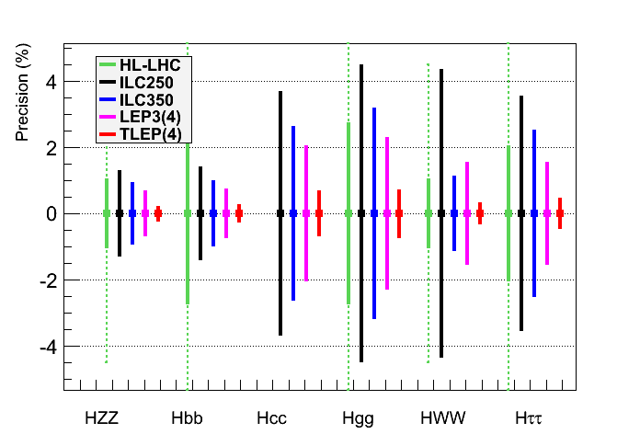
TLEP physics case as a Higgs factory
Same assumptions as for HL-LHC for a sound comparison
  Total width fixed to the sum of the visible partial widths + correction (Δg/g ~ 1/2 ΔBR/BR)
      TLEP : sub-percent precision, needed for (multi)-TeV New Physics sensitivity

Slide 30
Cost
It is clear that for such a project in its infancy, no cost estimate exists
This does not prevent one of us (P. Janot) to come up with his own very preliminary estimate which should be taken with a grain of salt.

Slide 31
Cost per Higgs – by Patrick Janot
LEP3 : A cost-effective option
  Tunnel : 0 $ - Cryoplant : 0$
  Two detectors : 0$ - Four detectors : 1 G$ Total : 1 – 2 G$
  RF + Magnets + Injector Ring : 1 G$
  100,000 Higgs boson / detector / 5 years @ 240 GeV : 5 k$ / Higgs boson
TLEP : A long-term vision
  Tunnel : 4 G$
  Four detectors : 2 G$ Total : 9 G$
  RF + Cryo + Magnet + Injector Ring : 3 G$
  500,000 Higgs boson / detector / 5 years @ 240 GeV : < 4.5 k$ / Higgs boson
Comparison with ILC
  Total Cost : > 10 G$
  70,000 Higgs boson / 5 years @ 240 GeV
of which 5 G$ in common
with SHE-LHC
> 150 k$ / Higgs boson

Slide 32
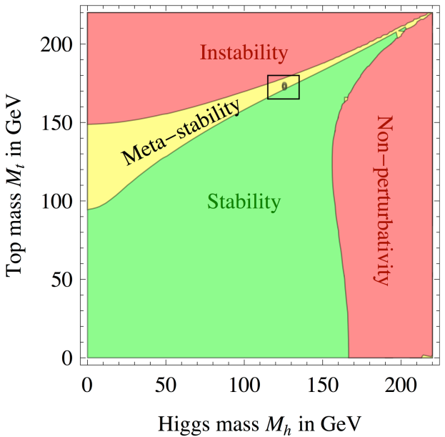
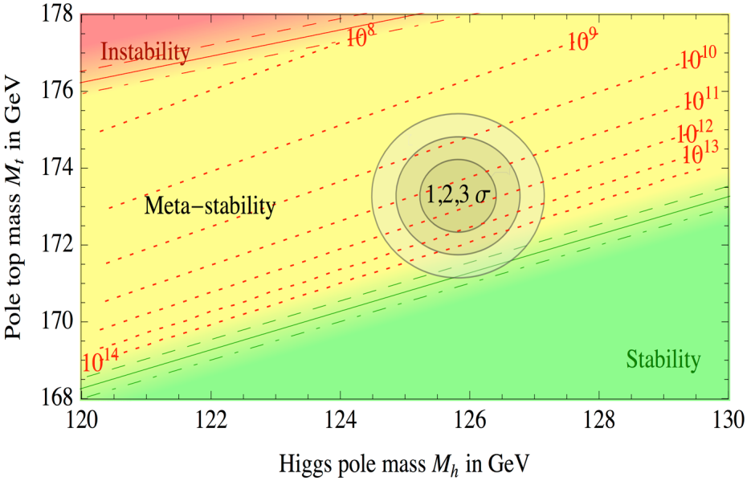
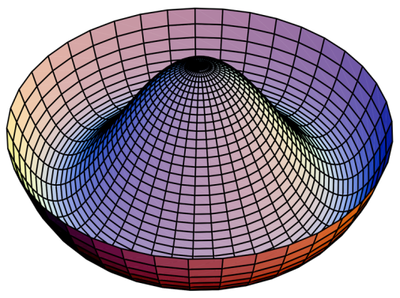
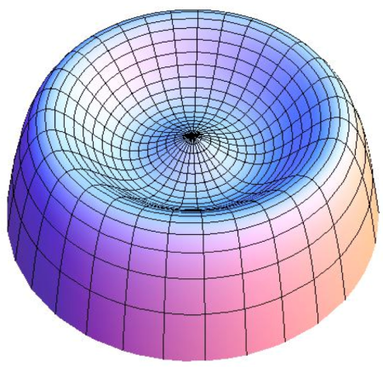
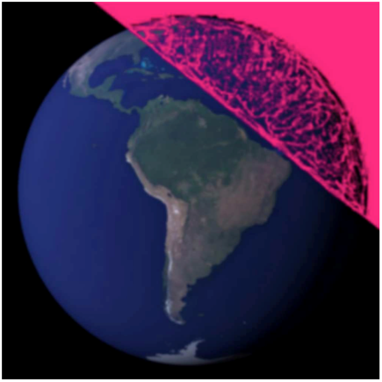
Top Measurements at √s ~ 350 GeV
Measurement of m_{top} perhaps more important than originally thought
Strumia et al, Moriond EW ‘13
Meta-stability favoured at 2σ : need to know m_{top} from e⁺e⁻
→
→

Slide 33
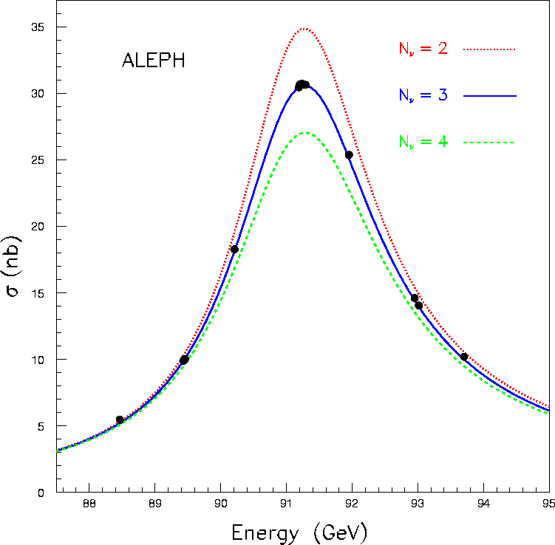
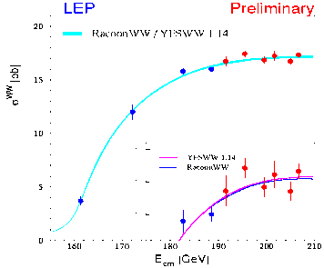
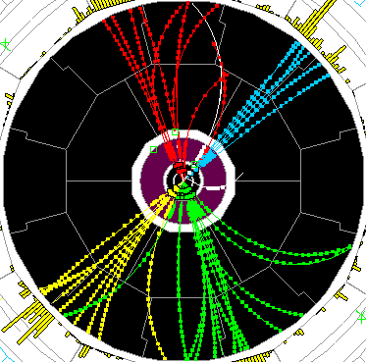
Smaller √s : Impact of TeraZ and MegaW
Revisit and improve the LEP precision measurements
  TLEP can do the entire LEP1 physics programme in 5 minutes (Detector calibration !)
  Important : Polarization up to the WW threshold with TLEP
    Very precise beam energy determination (10 keV) : unique to circular colliders
      Measure m_{Z}, Γ_{Z} to < 0.1 MeV, m_{W} to < 1 MeV, sin²θ_{W} to 2.10⁻⁶ from A_{LR}
Asymmetries, Lineshape
 | LEP | ILC | LEP3 | TLEP
√s ~ m_{Z} | MegaZ | GigaZ | ~TeraZ | TeraZ
Lumi (cm⁻²s⁻¹) #Z / year Polarization vs LEP1 | Few 10³¹ 2x10⁷ no 1 | Few 10³³ Few 10⁹ easy ~5-10 | Few 10³⁵ Few 10¹¹ yes (T, L) ~50 | 10³⁶ 10¹² yes (T,L) ~100
√s ~ 2m_{W}
Lumi (cm⁻²s⁻¹) Lumi / IP / year Error on m_{W} | Few 10³¹ 10 pb⁻¹ 220 MeV | Few 10³³ 50 fb⁻¹ 7 MeV | 5x10³⁴ 500 fb⁻¹ o.7 MeV | 2.5x10³⁵ 2.5 ab⁻¹ 0.4 MeV
√s ~ 200-250 GeV
Lumi (cm⁻²s⁻¹) Lumi / IP / 5 years Error on m_{W} | 10³² 500 pb⁻¹ 33 MeV | 5x10³³ 250 fb⁻¹ 3 MeV | 10³⁴ 500 fb⁻¹ 1 MeV | 5x10³⁴ 2.5 ab⁻¹ 0.4 MeV
WW threshold

Slide 34
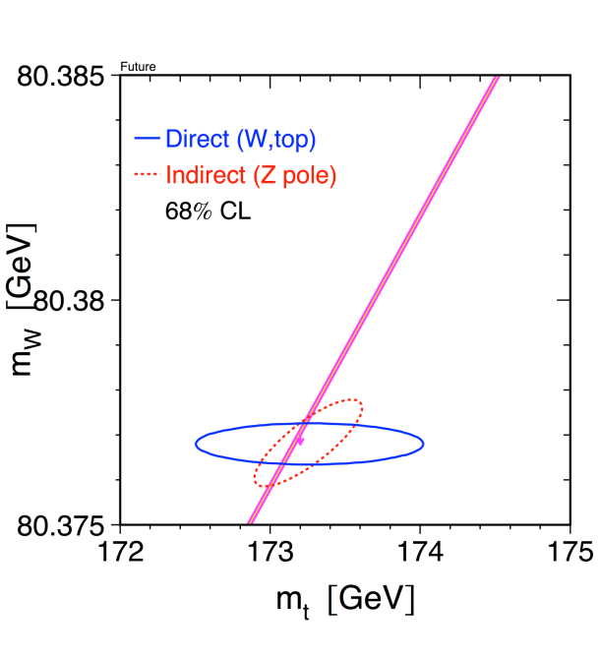
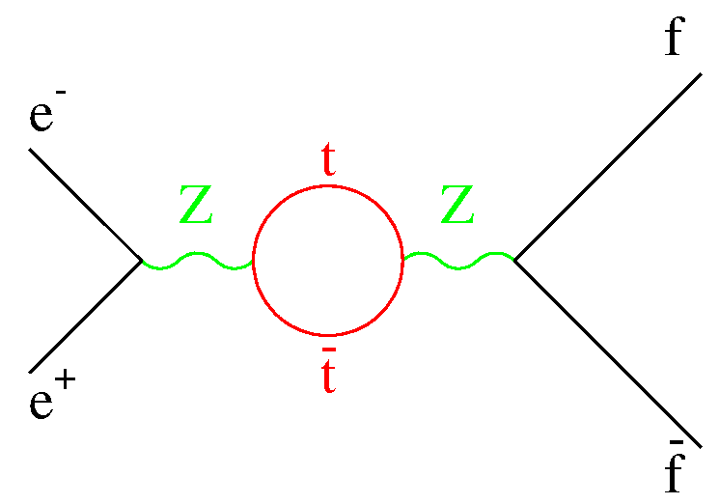
Smaller √s : Impact of TeraZ and MegaW
Case 1 : Only SM physics in EW Radiative Corrections – Stringent SM Closure test
  Set stringent limits on weakly interacting new physics (m_{H}, m_{W} and m_{top} known)
    Much theoretical work also needed
Case 2 : Some weakly interacting new physics in the loops ?
  Will cause inconsistency between the various observables
    Become sensitive to multi-TeV WINP
      LEP1 was sensitive to ~ 200 GeV (m_{top})
+
m_{H} = 126 GeV
M. Grunewald
Circular
(LEP3)
m_{W}
Linear
(ILC)
Circular
(TLEP)
?

Slide 35
Experimental challenges
Experimental challenges are numerous : TLEP(Z)
  At TLEP(Z), the hadronic Z event rate will be 30 kHz
    Same rate of bunch crossings as at LHC (40 MHz)
    CMS current high-level trigger rate is about 1 kHz
      (But hadronic Z events typically 20 times smaller than typical LHC event)
    Need to design a detector and a DAQ system able to cope with these rates
      A clever mixture of LHC detector (rate) and ILC detector (precision)
        Need to study what is the precision needed for each sub-detectors
        Is a CMS-like detector sufficient ? (~OK for Higgs studies)
  Small angle Bhabha event rate (lumi measurement) will be even larger : 120 kHz
    Essential to measure cross sections, hence the Z lineshape (m_{Z}, Γ_{z})
      Negligible beamstrahlung is a great advantage
        No background in the luminometers
        Energy spectrum perfectly known (hence Bhabha cross section)
      Will need theoretical developments to understand σ_{e+e−} to better than 5 x 10⁻⁵
  Limiting uncertainties on α_{QED}(m_{Z}) and α_{s}(m_{Z}) must be overcome
    Possible with the billions of e⁺e⁻ → e⁺e⁻(γ) , μ⁺μ⁻(γ) and qq(g) events ?
      Will affect all Z peak asymmetries, and m_{Z} vs m_{W} interpretation
P Janot, A. Blondel
N_{ν}
-

Slide 36
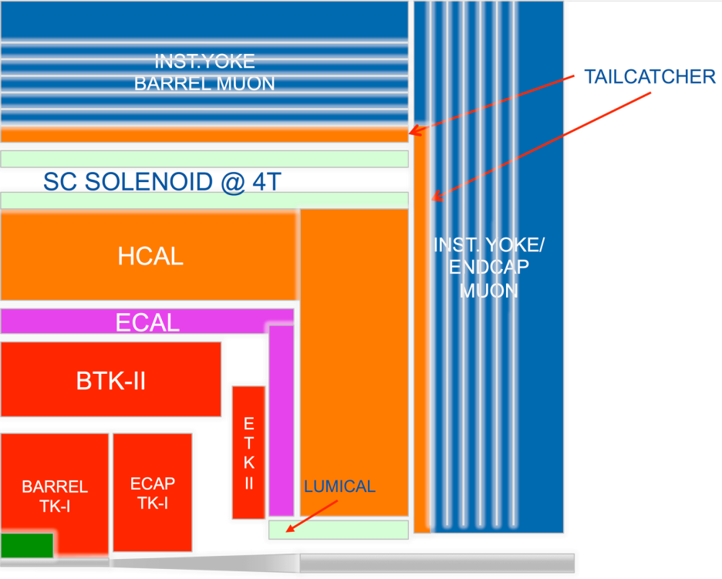
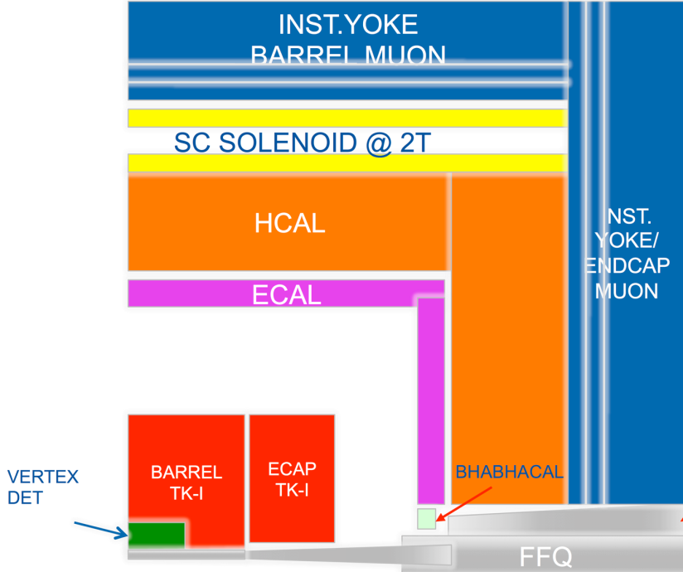
Detectors for TLEP and LEP3
For LEP3, obvious detectors are CMS and ATLAS
  CMS demonstrated to be adequate with today’s design + upgraded pixel detector
    Phase 2 upgrades : LEP3 could be seen as an alternative to HL-LHC
    Tunnel By-passes need to be dug out for the accelerating ring
For TLEP, new detectors are in order (used CMS for Higgs studies in this talk)
  Holistic approach: design caverns and detectors to be re-used in pp collisions (as new)
    TeraZ sets the scale for DAQ (2600 bunches) + forward EM calorimetry (lumi)
    TLEP(H) sets the scale for precision (tracker, ECAL, particle flow, b tagging)
    SHE-LHC sets the scale for magnetic field, calorimeter depths, tracker p_{T} reach
      Could envision a staged approach
E. Meschi
From TLEP…
…to VHE-LHC

Slide 37
Possible Timescales
Similar timescales for TLEP and LEP3
TLEP
  Design study : 2013-2017
  Next European Strategy Workshop : 2017-2018
  Decision to go and start digging : 2018-2019
  Start installation in parallel with HL-LHC running : 2023 - …
  Start running at the end of HL-LHC running : 2030 - …
LEP3
  Design study : 2013-2017 (spin-off of TLEP design study)
  Next European Strategy Workshop : 2017-2018
  Decision to go : 2018-2019
  Start installation at the end of LHC running : 2022 - …
    Tunnel probably irradiated at the end of HL-LHC
      LEP3 is an alternative of HL-LHC, and could be followed by HE-LHC in 2040
  Start running when ready : 2027 - …
 | 2010 |  |  |  |  |  | 2015 |  |  |  |  | 2020 |  |  |  |  | 2025 |  |  |  |  | 2030 |  |  |  |  | 2035 |  |  |  |  | 2040
LHC
HL-LHC | R&D + constr
TLEP* |  |  |  | Design + R&D + construction
VHE-LHC* | Design + R&D + construction

Slide 38
European strategy
Recommendations from European Strategy Group
  High-priority large-scale scientific activities
    Recommendation #2
    Excerpt from the CERN Council deliberation document (22-Mar-2013)
d) To stay at the forefront of particle physics, Europe needs to be in a position to propose an ambitious post-LHC accelerator project at CERN by the time of the next Strategy update, when physics results from the LHC running at 14 TeV will be available.
CERN should undertake design studies for accelerator projects in a global context, with emphasis on proton-proton and electron-positron high-energy frontier machines. These design studies should be coupled to a vigorous accelerator R&D programme, including high-field magnets and high-gradient accelerating structures, in collaboration with national institutes, laboratories and universities worldwide.
The two most promising lines of development towards the new high energy frontier after the LHC are proton-proton and electron-positron colliders. Focused design studies are required in both fields, together with vigorous accelerator R&D supported by adequate resources and driven by collaborations involving CERN and national institutes, universities and laboratories worldwide. The Compact Linear Collider (CLIC) is an electron-positron
machine based on a novel two-beam acceleration technique, which could, in stages, reach a centre-of-mass energy up to 3 TeV. A Conceptual Design Report for CLIC has already been prepared. Possible proton-proton machines of higher energy than the LHC include HE-LHC, roughly doubling the centre-of-mass energy in the present tunnel, and V-LHC, aimed at reaching up to 100 TeV in a new circular 80km tunnel. A large tunnel such as this could also host a circular electron-positron machine (TLEP) reaching energies up to 350 GeV with high luminosity.

Slide 39
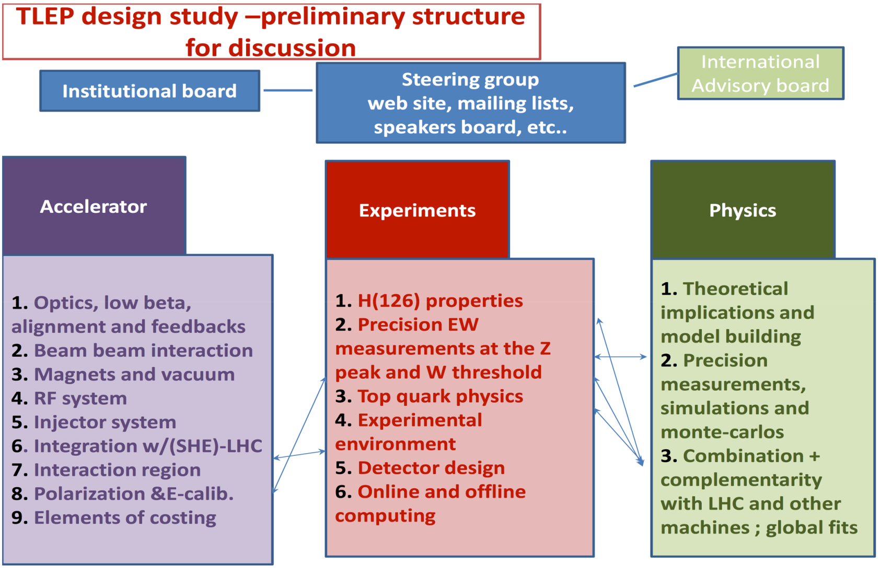
Design Study : 2013 – 2018

Slide 40
Who are we?
TLEP Steering group (ad interim)
  Roy Aleksan
  Alain Blondel
  John Ellis
  Patrick Janot
  Mike Koratzinos
  Marco Zanetti
  Frank Zimmermann

Slide 41
Conclusions
TLEP is a unique project for Europe and the HEP community
It offers the best performance compared to similar cost and timescale projects
LEP3 offers an excellent backup plan
It is upgradable to a very high energy pp collider (~100TeV)
The design study effort has just started: it is an exciting project with short delivery times (2018)
We need to wait for the LHC 14TeV run, but there is a high chance that TLEP/VHE-LHC will be the best way to go for the next 50 years

Slide 42
Join us!
You can contribute to the design study by filling the form
  http://tlep.web.cern.ch/contribute-to-the-design-study
  …indicating in which field you would like to contribute
  (no MoU currently, institution board to be assembled)
Kick-off meeting (at CERN) expected end of the year/beginning of 2014
Currently 174 expressions of interest – only 5 Greeks

